Slide 1
This, that, these and those.
UNIT 2B

Slide 2

Agenda
Review: Demonstratives
Numbers
Vocabulary: Souvenirs
Jobs
Technology II
Reading: Jobs in IT

Slide 3

Learning objectives
The student will be able to comprehend the use of demonstratives in context.
The student will explore the jobs and technology field.

Slide 4
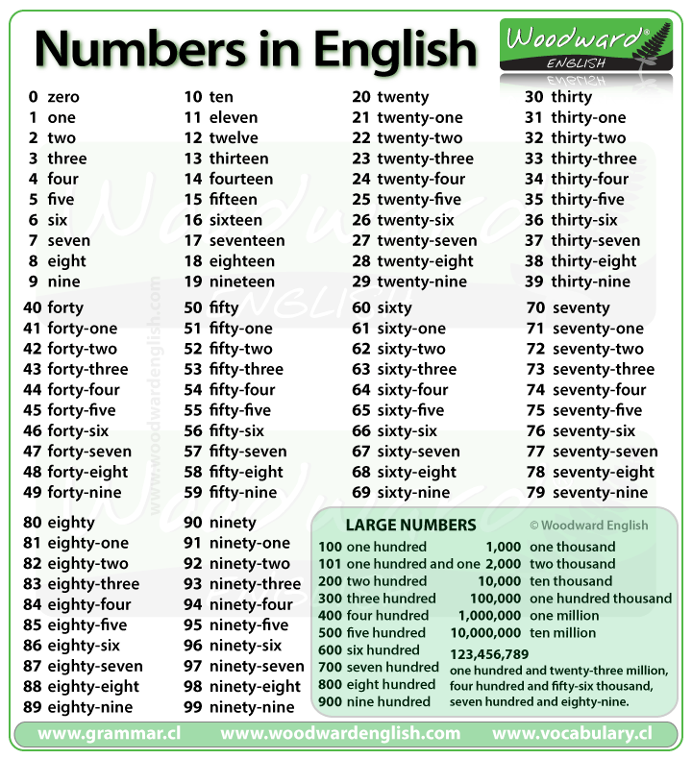
Cardinal numbers
20 – 12= ?
35 – 18 = ?
91 – 23 = ?
56 – 30 = ?
67 – 51 = ?
Tip! (-) minus (x) by
5 x 9 = ?
7 x 7 = ?
2 x 8 = ?
9 x 6 = ?
4 x 5 = ?

Slide 5
Vocabulary: Souvenirs
Cap
Mug
T-shirt
Bracelet
Postcard

Slide 6

Comprehension task
Gap fill: using “That, This, These or Those”.
Look at _____ bracelet over there!
_____ postcards look great on my wall.
Hi! David _____ is my friend Sandy.
Can I have a look at _____ caps?
_____ is my new T-shirt, I love it!
that
These
this
those
This

Slide 7
Technology II
Anti-virus
Forum
Robot
Online dating
Online encyclopedia
Game ☺

Slide 8
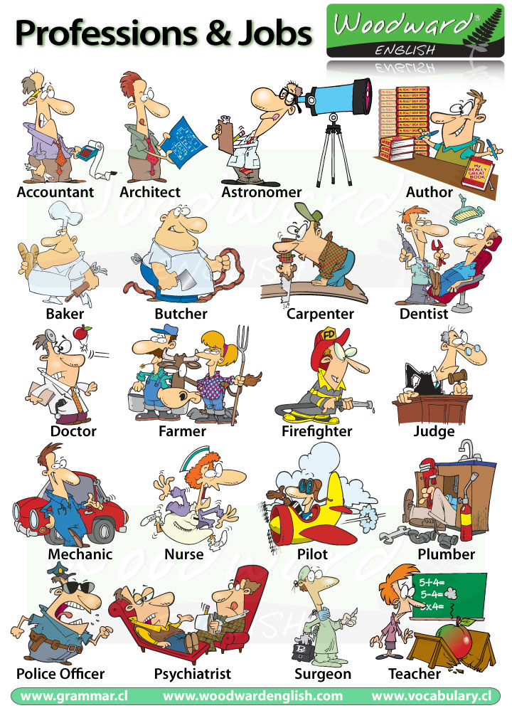
Professions
What is your profession?
What do you do?
What do you do for living?
https://youtu.be/8YAqzgv9XUI

Slide 9
Jobs in IT
Network
Architect
Information Technology (IT)
Database

Slide 10


Reading: Jobs in IT
Hi! I'm Sylvia. I create usernames and passwords and I set firewalls. This is Isabelle. Her job is to plan and design the network. And this is Andrew. His job is to make sure all the computers work properly. Finally, Mark and Martika. Their area is data processing. We all work for the university. Our offices are in building 8.
Sylvia is a…
Isabelle is a…
Andrew is an…
Mark and Martika are…
Network administrator
Network architect
IT support officer
Database analyst
Olejniczak, M. (2015). In English for information technology 1: course book (pp. 2–3). essay, Pearson Education Limited.

Slide 11
Tongue twister
I walk to work but I don’t work to walk.

Slide 12

10 difficult words to pronounce in English

Slide 13
Speaking
Listening
YouGlish
https://www.radio-uk.co.uk/
English tips

Slide 14


